Slide 1
TypeShield: Practical Forward Edge Based Attack Protection
Paul Muntean
Department of Computer Science
Technical University of Munich, Germany
28.06.2017

Slide 2
Outline
Introduction
Background
Overview
Design
Evaluation
Conclusion

Slide 3
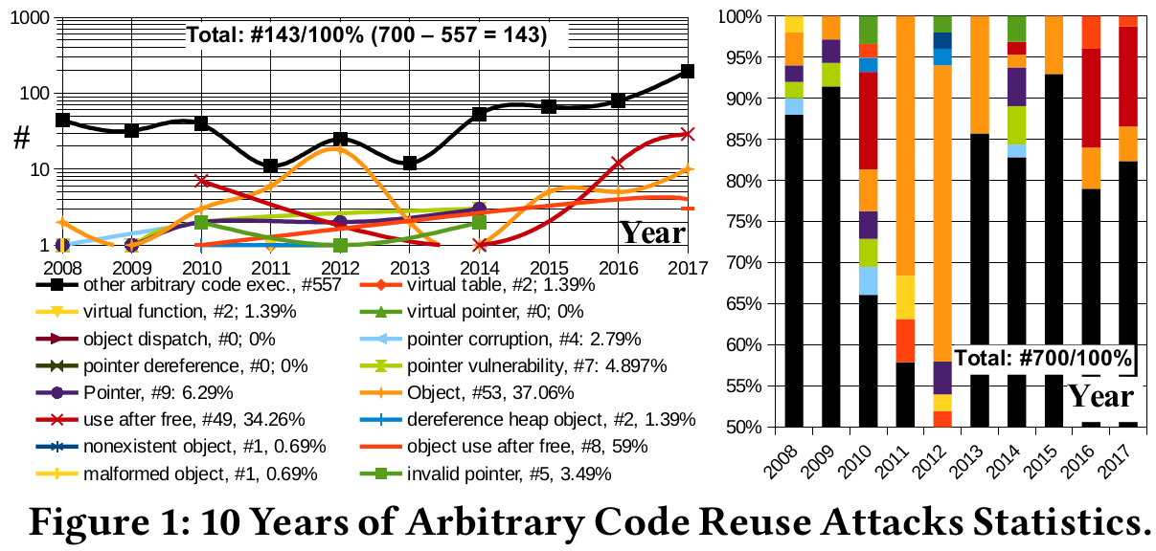
Introduction
*just U.S. NVD data, as of May 2017

Slide 4
Introduction
What is the problem?
  Forward edges in binary programs can be easilly corrupted to perform code reuse attacks (CRAs)
What are the current solutions?
  A plethora of binary and source code tools for runtime forward edge protection
Where are the limitations of these solutions?
  Poor to good precision w.r.t. calltarget reduction per forward edge indirect control flow transfer
What is our idea/insight?
  Combine function parameter count and paramter types (register wideness) for a fine grained CFI-based policy for forward edge indirect control flow transfers in binaries programs
What are our contributions?
  1. Novel Forward Edge Based Attacks Mitigation Technique, 2. Implemented Prototype, 3. Security Analysis, 4. Evaluation, 5. Detailed Comparison, 6. Usable Prototype and Results Reproducibility, 7. Platform for mitigation of other CRAs

Slide 5
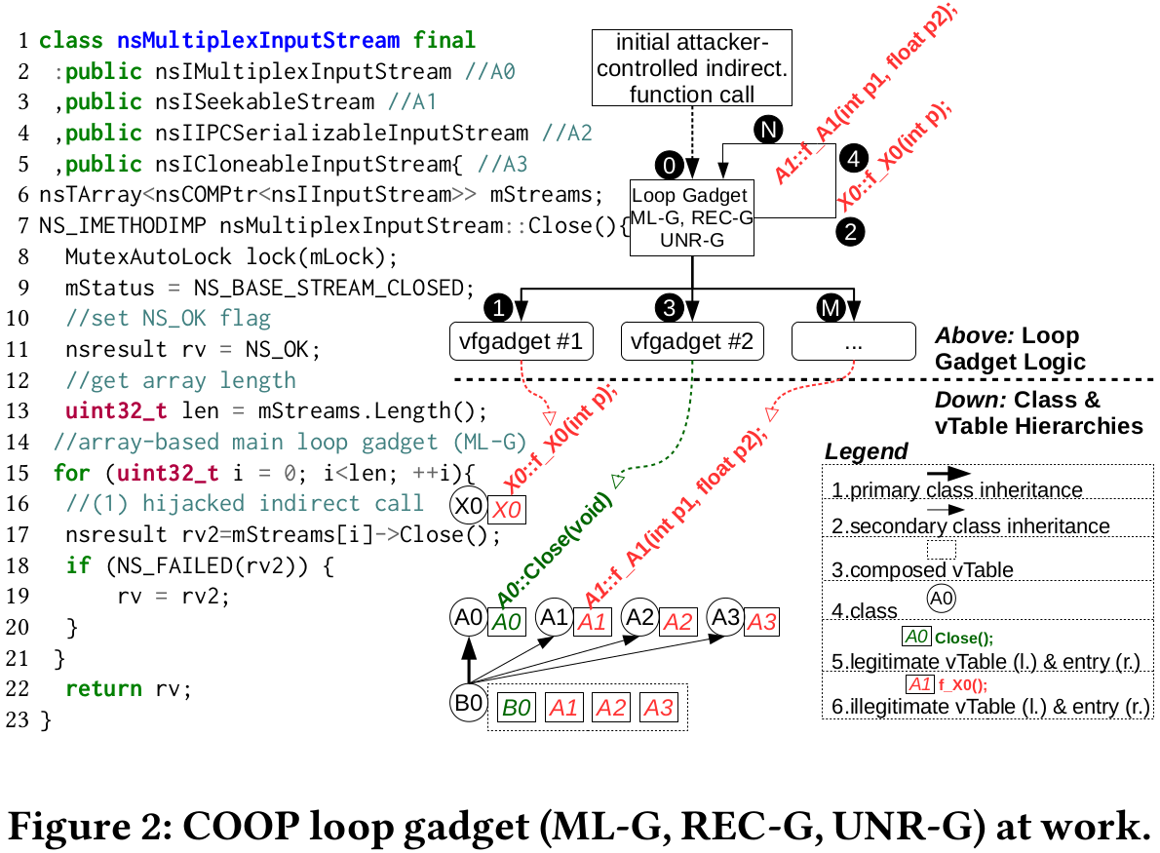

Background
System V ABI x86-64 Bit: Parameters to functions are passed in the registers rdi, rsi, rdx, rcx, r8, r9, and further values are passed on the stack in reverse order
Microsoft ABI uses 4 registers and the rest is passed over the stack
Alias analysis in binaries is undecidable, see Ramalingam et al. TOPLAS'94 paper; one reason for CRAs
DEP, ASLR etc. bypassed
10 Mb. binary → 10 Mil. poss. addresses to jump
Call site (start of forward edge), call target (end of forward edge), not only!
Code extracted from Mozilla Firefox

Slide 6
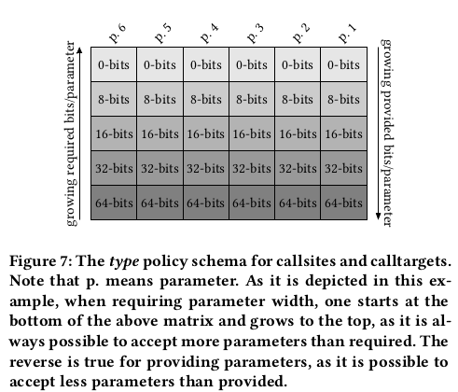
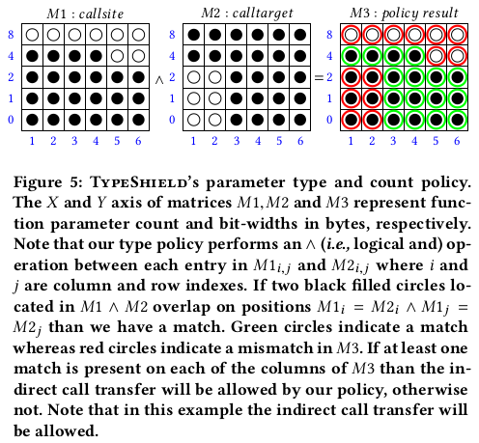
Overview

Slide 7
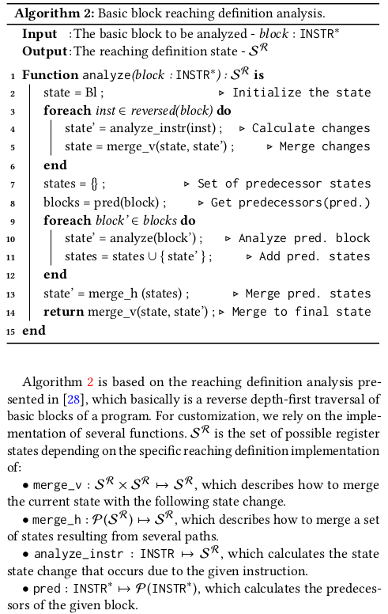
Design
Call site
analysis

Slide 8
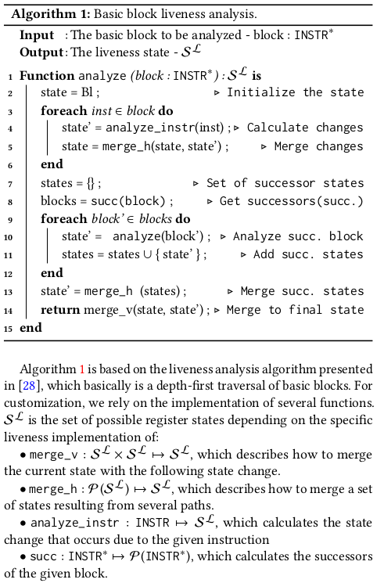
Design (cont.)
Call target
analysis

Slide 9
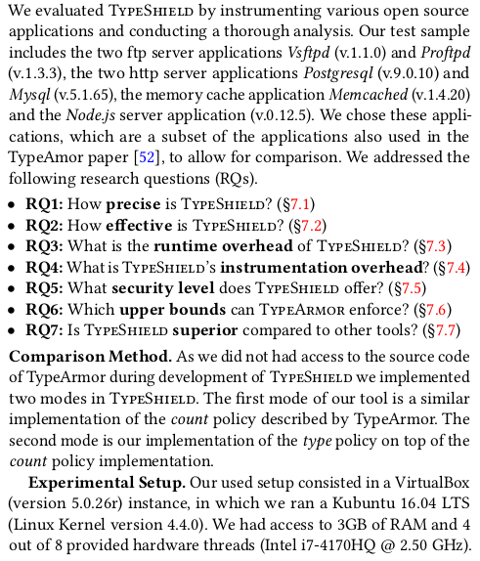
Evaluation

Slide 10
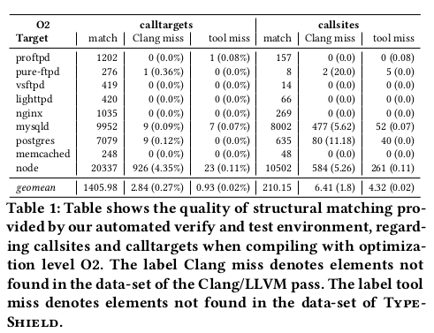
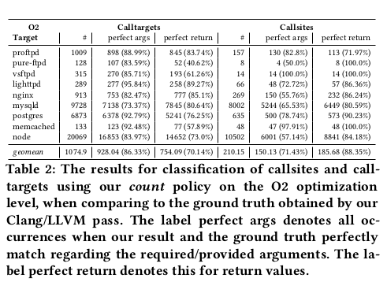
RQ1: Precision

Slide 11
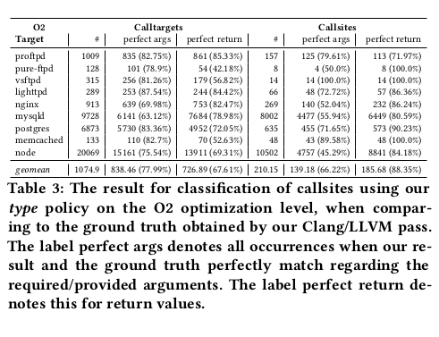
RQ1: Precision (cont.)

Slide 12
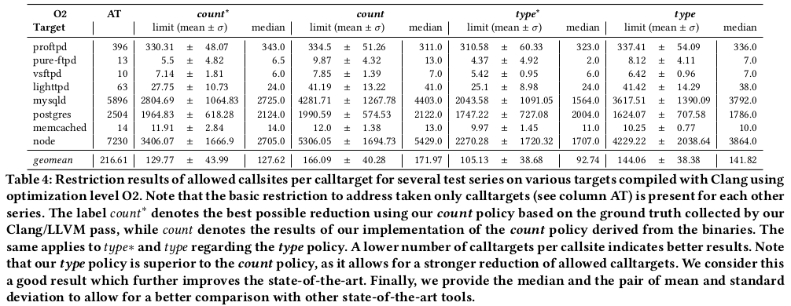
RQ2: Effectiveness

Slide 13
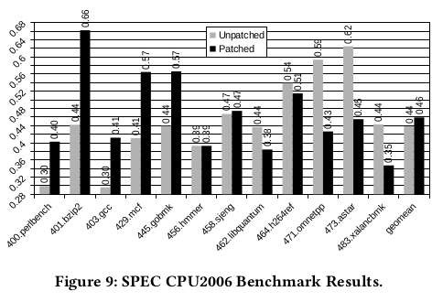
RQ3: Runtime Overhead
We measured an average 4% runtime overhead when instrumenting with DynInst
One reason for the performance drop includes cache misses introduced by jumping between the old and the new executable section of the binary generated by duplicating and patching
This is also dependent on the actual structure of the target, as it depends on the number of indirect control flow operations pertime unit
Another reason for the slightly higher (yer acceptable) overhead is due to our runtime policy which is more complex than that of other state-of-the-art tools (3%)

Slide 14
RQ4: Instrumentation Overhead
Binary blow up was on average 50% and up to 150% for Postgres
This is due to relocations and the fact that each basic block in the old code contains a jump instruction to the new position of 0 the basic block
There is still place for tweeks and we are currently addressing them

Slide 15
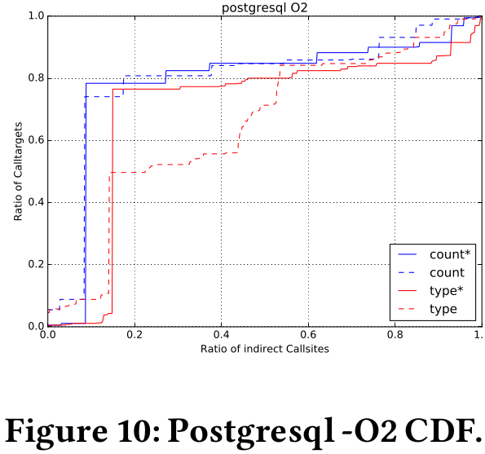
RQ5: Security Analysis of TypeShield

Slide 16
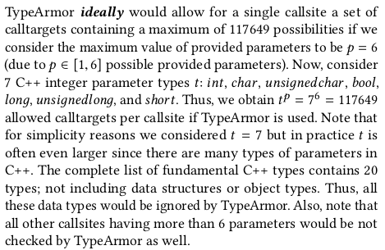
RQ6: TypeArmor Upped Bounds: Ideally

Slide 17
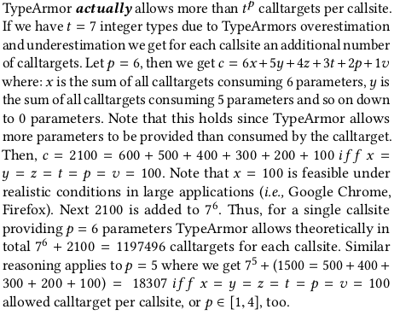
RQ6: TypeArmor Upped Bounds: Actually

Slide 18
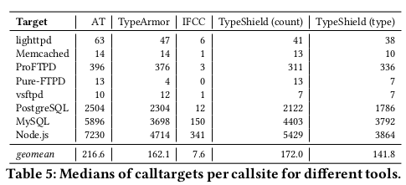
RQ7: Is TS superior to other forward edge tools?

Slide 19
Conclusion
TS is a binary runtime fine-grained CFI-policy enforcing tool for forward edges
TS was applied to real software such as web servers, FTP servers and the SPEC CPU2006 benchmark
TS has higher precision w.r.t. the calltarget set per callsite than existing state-of-the-art tools, while maintaining a comparable runtime overhead of 4%
TS improves parameter count based techniques by reducing the possible call-targets per callsite ratio by 35% with an overall reduction of more than 13% when comparing with similar state-of-the-art tools (e.g., TypeArmor)
The outcome is a considerably reduced attack surface which can be further improved by tweaking our analysis
TS can serve as a platform for other types of code reuse attacks mittigation
Future Work
  Improving the Structural Matching (improve our analysis)
  Improving the Patching Schema (reduce runtime overhead)
  Using Pointer and Memory Analysis (more detailed parameter type lattice)

